Slide 1
Finding the Right Co-Founder
Wed September 8 2020
Antler Program

Slide 2
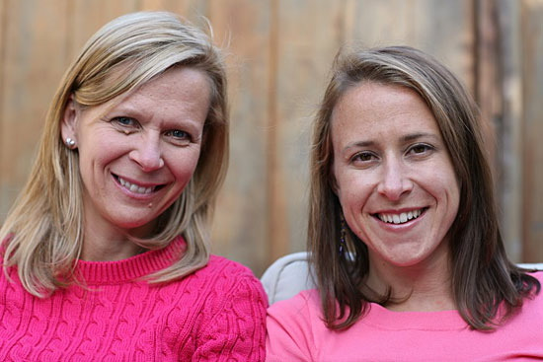

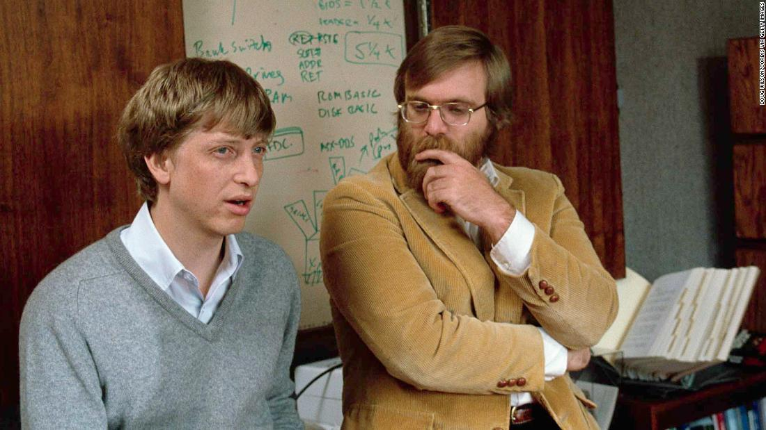
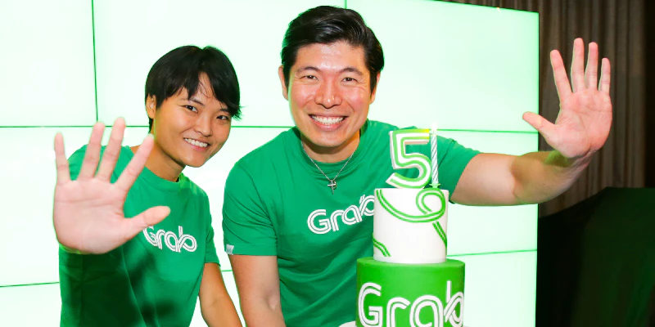
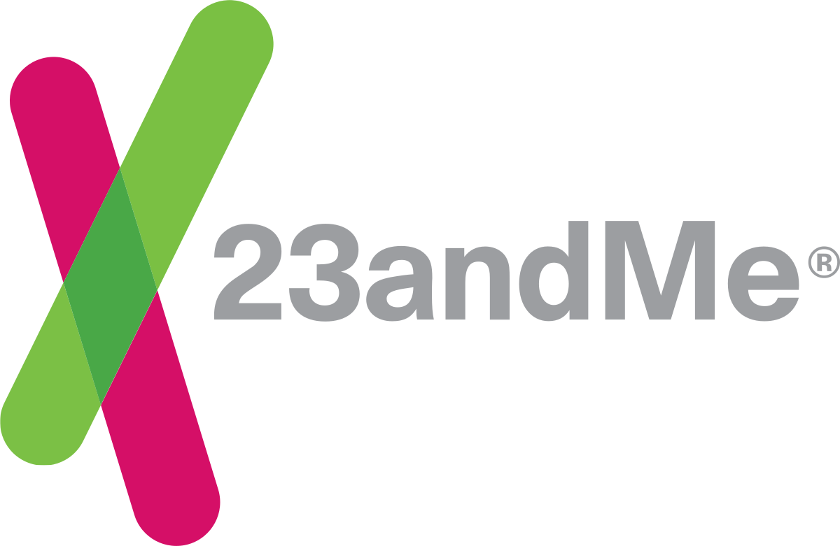

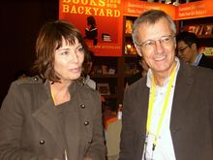


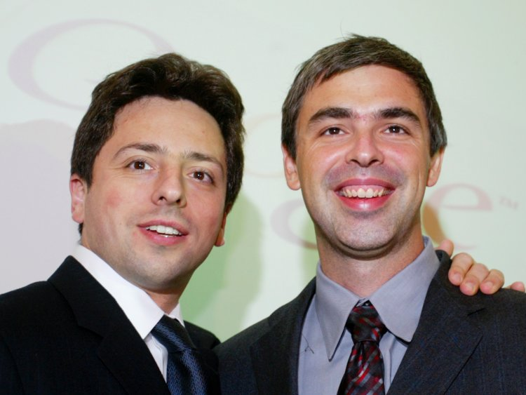
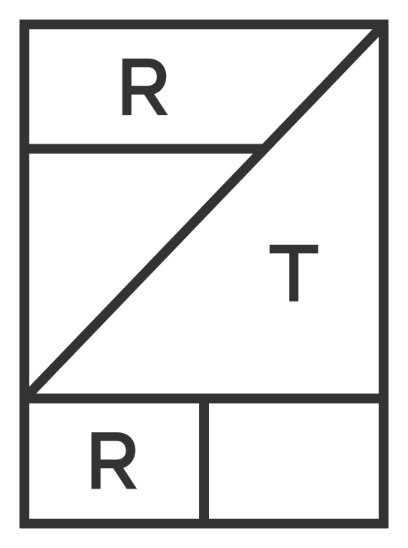

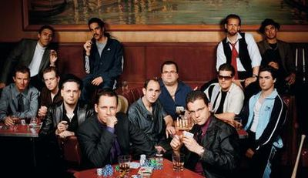
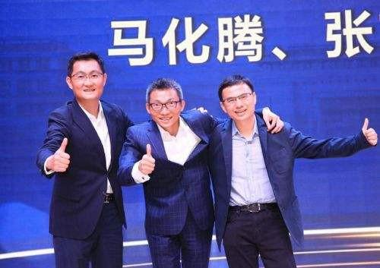


Finding the right co-founders — a billion-dollar opportunity!

Slide 3
FINDING THE RIGHT CO-FOUNDER: THE 2P3 FRAMEWORK
1 – PROFESSIONAL
2 – PERSONAL
Skills
Vision
Commitment
(Culture)
Personal Affinity
1
2
3
3
Personality
Values
Personality
2
1
1
YOUR IDEAL CO-FOUNDER

Slide 4
1 of 4
FINDING THE RIGHT CO-FOUNDER: THE 2P3 FRAMEWORK
1 – PROFESSIONAL
2 – PERSONAL
Skills
Vision
Commitment
(Culture)
Personal Affinity
1
2
3
3
Personality
Values
Personality
2
1
1
YOUR IDEAL CO-FOUNDER

Slide 5
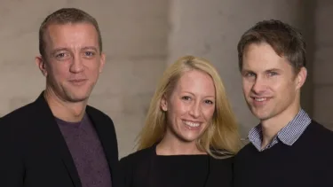

COMPLEMENTARY SKILLS OF EACH POTENTIAL CO-FOUNDER
Hard and soft skills
Skills that are indispensable for the company in early stages
Areas of ownership for first 1-2 years (CEO, CTO, CPO)
Team-market fit
Face of the company
Complementary
Homogeneous
Notes:
Eventbrite, a self-service ticketing platform, was born in a wiring closet in 2006. Julia was in charge of customer experience and business operations, while Kevin and Renaud worked on the product. Today, Eventbrite has a valuation north of $1 billion.

Slide 6
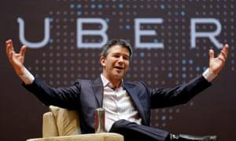
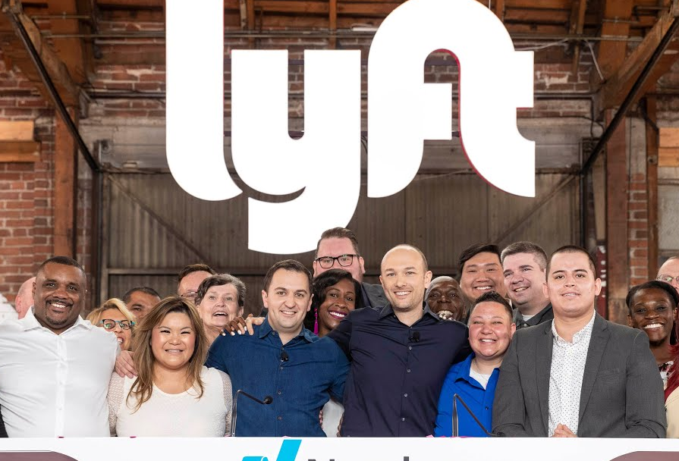
Homogeneous vision and commitment
Personal goals (e.g. control, liquidity event); exit: $100M? $1B?
Equity split
Full commitment for the long-term
Personal cash needs in the short-term
Salaries pre-seed investment
Complementary
Homogeneous
Notes:
Lyft is known for consistently communicating its positive values to its employees and customers. Uber, of course, is known for the opposite.

Slide 7
2 of 4
FINDING THE RIGHT CO-FOUNDER: THE 2P3 FRAMEWORK
1 – PROFESSIONAL
2 – PERSONAL
Skills
Vision
Commitment
(Culture)
Personal Affinity
1
2
3
3
Personality
Values
Personality
2
1
1
YOUR IDEAL CO-FOUNDER

Slide 8
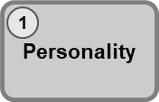






OCEAN: The Big Five Taxonomy
The Big Five dimensions are considered to be the key underlying traits that make up an individual’s personality. The Big Five traits are often referred to as OCEAN
Openness
Extraversion
Neuroticism
Conscientiousness
Agreeableness
Keep in mind:
There are no right and wrong answers (high and low are not ratings)
There are infinite combinations of Big Five traits just as every personality is unique
For the assessment: garbage in, garbage out
Personality is just one of the factors determining success
Notes:
Who has done it before?
Did you have a look at your result?
Do you self-identify?
Did you have a look at others’ results?

Slide 9

Extraversion
In general, extroverts draw energy or “recharge” from interacting with others, while introverts get tired from interacting with others and replenish their energy from solitude
Sociable
Outgoing
Energetic
Talkative
Affectionate
Friendly
Source: Lebowitz, 2016
Notes:
People high in extroversion tend to seek out opportunities for social interaction, where they may be identified from afar as “life of the party.” They are comfortable with others, gregarious, and prone to action rather than contemplation – great for Sales, Business Development, etc.
People low in extroversion are more likely to be people “of few words,” people who are quiet, introspective, reserved, and thoughtful – they may be the ones who will be cracking codes and sending humanity to Jupiter.

Slide 10

Agreeableness
This factor concerns how well people get along with others. While extroversion concerns sources of energy and the pursuit of interactions with others, agreeableness concerns your orientation to others
Trusting
Modest
Patient
Moderate
Kind
Unselfish
Helpful
Sensitive
Considerate
Source: Lebowitz, 2016
Notes:
People high in agreeableness tend to be conscious of how others react to them … and as a result may likely have few enemies, are sympathetic, and affectionate to their friends and loved ones
People on the low end of the agreeableness spectrum are less likely to be concerned by what others think of them … . They tend to be more blunt, ill-tempered and aren’t out to leave others with a warm fuzzy feeling – if you have a large operations and you’re driving a tight ship, you may need ths no-nonsense hammer personality keep the ship off an iceberg at all times, without feeling mean about it.

Slide 11

Conscientiousness
Conscientiousness is a trait that can be described as the tendency to control impulses and exhibit goal-directed behavior. Conscientious people excel in their ability to delay gratification, work systematically, and plan and organize effectively
Persistent
Thorough
Self-disciplined
Consistent
Predictable
Reliable
Hard working
Planner
Source: Lebowitz, 2016
Notes:
Often people who’re high on this are CFOs and lower ones are sales and marketing.
I think of Bill Gates as being high on this scale. The products are functional but clinical – built with some laboratory precision of a far planned long term goal. And not apple at all.

Slide 12

Neuroticism
Neuroticism is the only Big Five factor in which a high score indicates may appear to have more negative traits. It is not a factor of meanness or incompetence.
Moody
Nervous
Anxious
Self-critical
Oversensitive
Pessimistic
Source: Lebowitz, 2016
Notes:
Those high in neuroticism may be temperamental, potentially a bit unsure of themselves as they tend to drive self-criticism above what others expect of them. This personality reminds me of artists.
Individuals who score on the low end of neuroticism are more likely to feel confident and adventurous. They may also be brave and unencumbered by worry or self-doubt
If I had to give Steve Jobs a personality test, I’d put him high on neurotic.

Slide 13
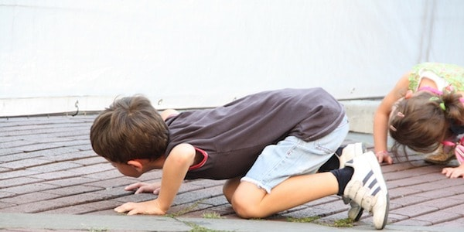
Openness
Openness to experience concerns an individual’s willingness to try to new things, to be vulnerable, and the ability to think outside the box
Imaginative
Insightful
Wide range of interests
Daring
Creative
Curious
Intellectual
Source: Lebowitz, 2016
Notes:
High in openness to experience means love of learning, enjoys the arts, engages in a creative career or hobby, and likes meeting new people
Low in openness to experience means people may prefer routine over variety, and stick to what they know -- this personality is important to ensure that you continuously have somebody pushing your team to focus, while high openness counterparts may be pushing you to explore.

Slide 14
Still not convinced?
Let’s have another look at the Marshmallow Challenge from this morning …
Notes:
Ask Team A (complementary): How was it? What went well, what did not go so well? How did the personalities match? -> show them dashboard
Ask Team Z (disfunctional) same questions
Show them slide with results: height of tower (hopefully disfunctional team got a lot lower tower)
Give them averages of the two types of teams (on 2 slides) - without revealing what the difference was
Reveal in dashboard what we did with teams

Slide 15
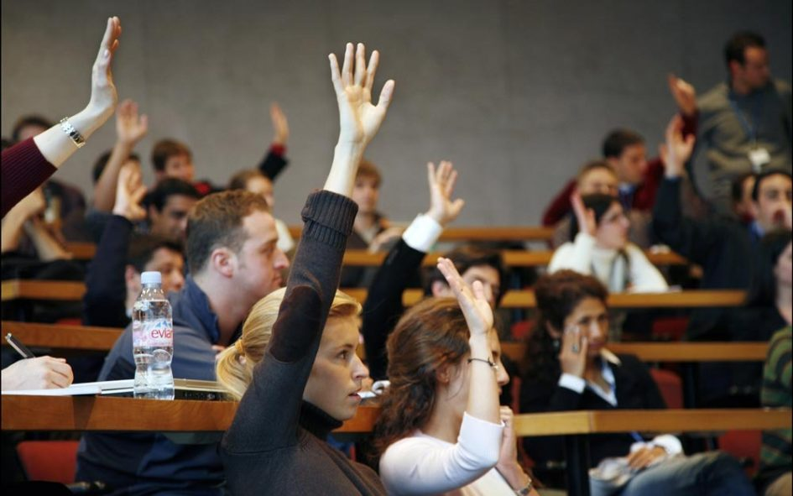
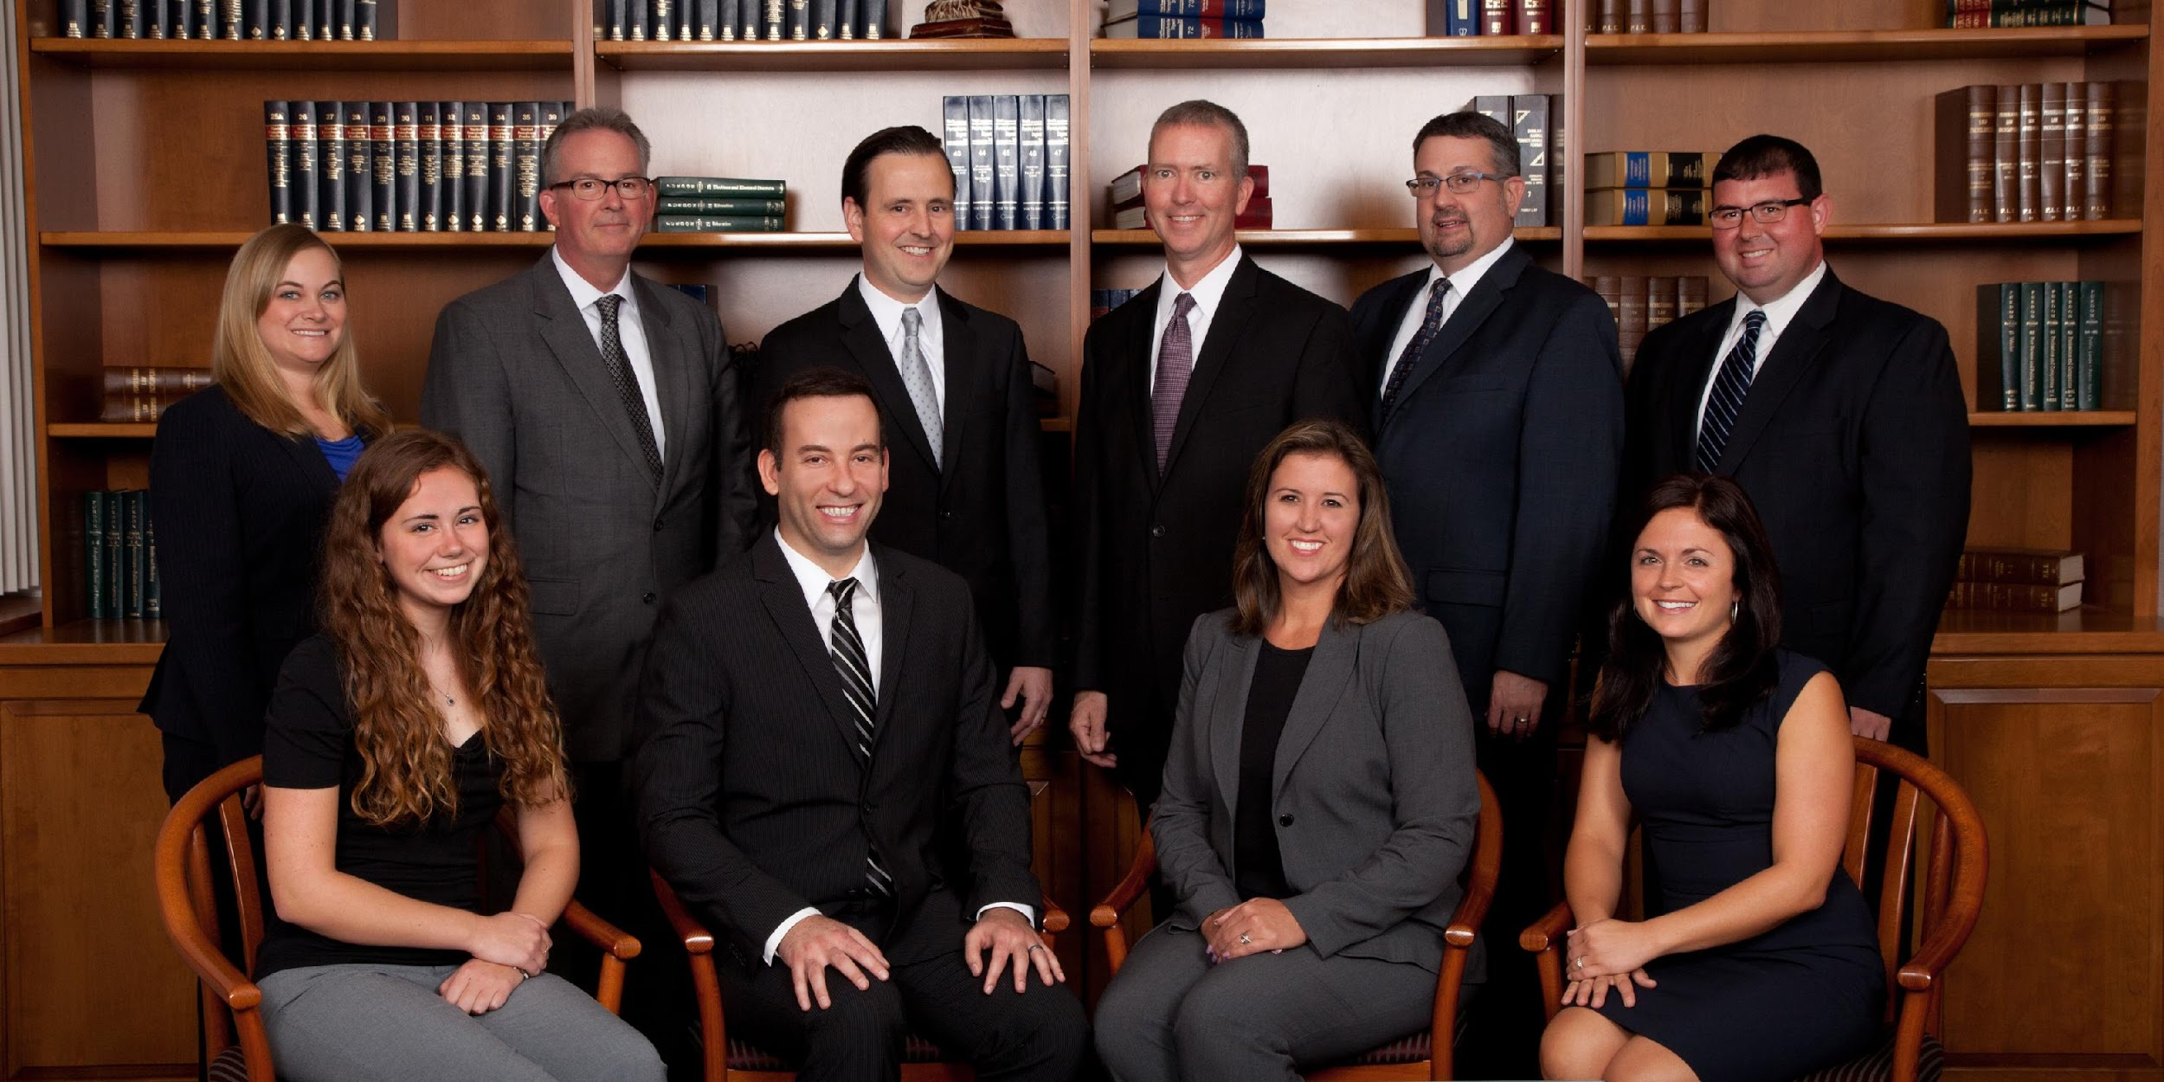
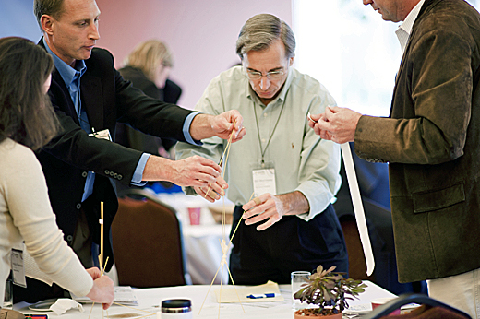
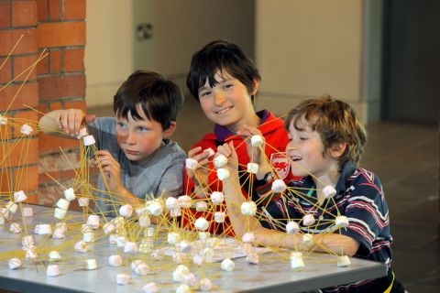
The Marshmallow Challenge
25 cm
38 cm
51 cm
65 cm
1 + 1 = 0.5
1 + 1 = 1.5
1 + 1 = 3
Your company’s success will be determined by how large the sum will be
Notes:
"A few years ago the designer and engineer Peter Skillman held a competition to find out. Over several months, he assembled a series of four-person groups at Stanford, the University of California, the University of Tokyo, and a few other places. He challenged each group to build the tallest possible structure using the following items: • twenty pieces of uncooked spaghetti • one yard of transparent tape • one yard of string • one standard-size marshmallow The contest had one rule: The marshmallow had to end up on top. The fascinating part of the experiment, however, had less to do with the task than with the participants. Some of the teams consisted of business school students. The others consisted of kindergartners. The business students got right to work. They began talking and thinking strategically. They examined the materials. They tossed ideas back and forth and asked thoughtful, savvy questions. They generated several options, then honed the most promising ideas. It was professional, rational, and intelligent. The process resulted in a decision to pursue one particular strategy. Then they divided up the tasks and started building. The kindergartners took a different approach. They did not strategize. They did not analyze or share experiences. They did not ask questions, propose options, or hone ideas. In fact, they barely talked at all. They stood very close to one another. Their interactions were not smooth or organized. They abruptly grabbed materials from one another and started building, following no plan or strategy. When they spoke, they spoke in short bursts: “Here! No, here!” Their entire technique might be described as trying a bunch of stuff together. If you had to bet which of the teams would win, it would not be a difficult choice. You would bet on the business school students, because they possess the intelligence, skills, and experience to do a superior job. This is the way we normally think about group performance. We presume skilled individuals will combine to produce skilled performance in the same way we presume two plus two will combine to produce four. Your bet would be wrong. In dozens of trials, kindergartners built structures that averaged twenty-six inches tall, while business school students built structures that averaged less than ten inches.*1 The result is hard to absorb" (from "The Culture Code: The Secrets of Highly Successful Groups" by Daniel Coyle)

Slide 16
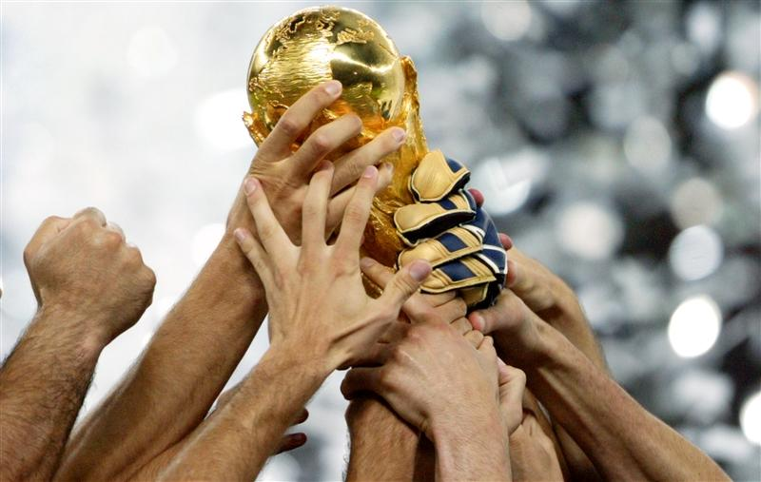
We have a WINNER!!!
Teams 1-9
Teams 10-23
86 cm
Team 1
Ashish Patel
Daniel Nordberg
David Lemayian
Sonali Sanghrajka

Slide 17
Teams
Cluster A
Tuesday
Sept 8
Team 1 – 86CM
Ashish Patel
Daniel Nordberg
David Lemayian
Sonali Sanghrajka
25cm
86cm
83cm
Team 3 – 25CM
David Njonjo
Jamie Pujara
Mikul Shah
Team 2 – 83CM
Ore Alemede
Peng Chen
Simon Sondern
Tracy Matia
Cluster B Wednesday
Sept 8
43cm
Team 4 – 42cm
Job Dulo
Ronald Kudoyi
Walela Masibo
Yixuan "Layla" Li
Team 5 – 0cm
Alistair Gould
Brian Mwangi
Clementine Vandeleur
Team 6 - 43
James Macharia
Peter Kihara
Joyce Mbaya-Ikiao
42cm
0cm

Slide 18
Teams
Cluster A
Tuesday
Sept 8
Team 1 – 86CM
Ashish Patel
Daniel Nordberg
David Lemayian
Sonali Sanghrajka
25cm
86cm
83cm
Team 3 – 25CM
David Njonjo
Jamie Pujara
Mikul Shah
Team 2 – 83CM
Ore Alemede
Peng Chen
Simon Sondern
Tracy Matia
Cluster B Wednesday
Sept 8
43cm
Team 4 – 42cm
Job Dulo
Ronald Kudoyi
Walela Masibo
Yixuan "Layla" Li
Team 5 – 0cm
Alistair Gould
Brian Mwangi
Clementine Vandeleur
Team 6 - 43
James Macharia
Peter Kihara
Joyce Mbaya-Ikiao
42cm
0cm

Slide 19
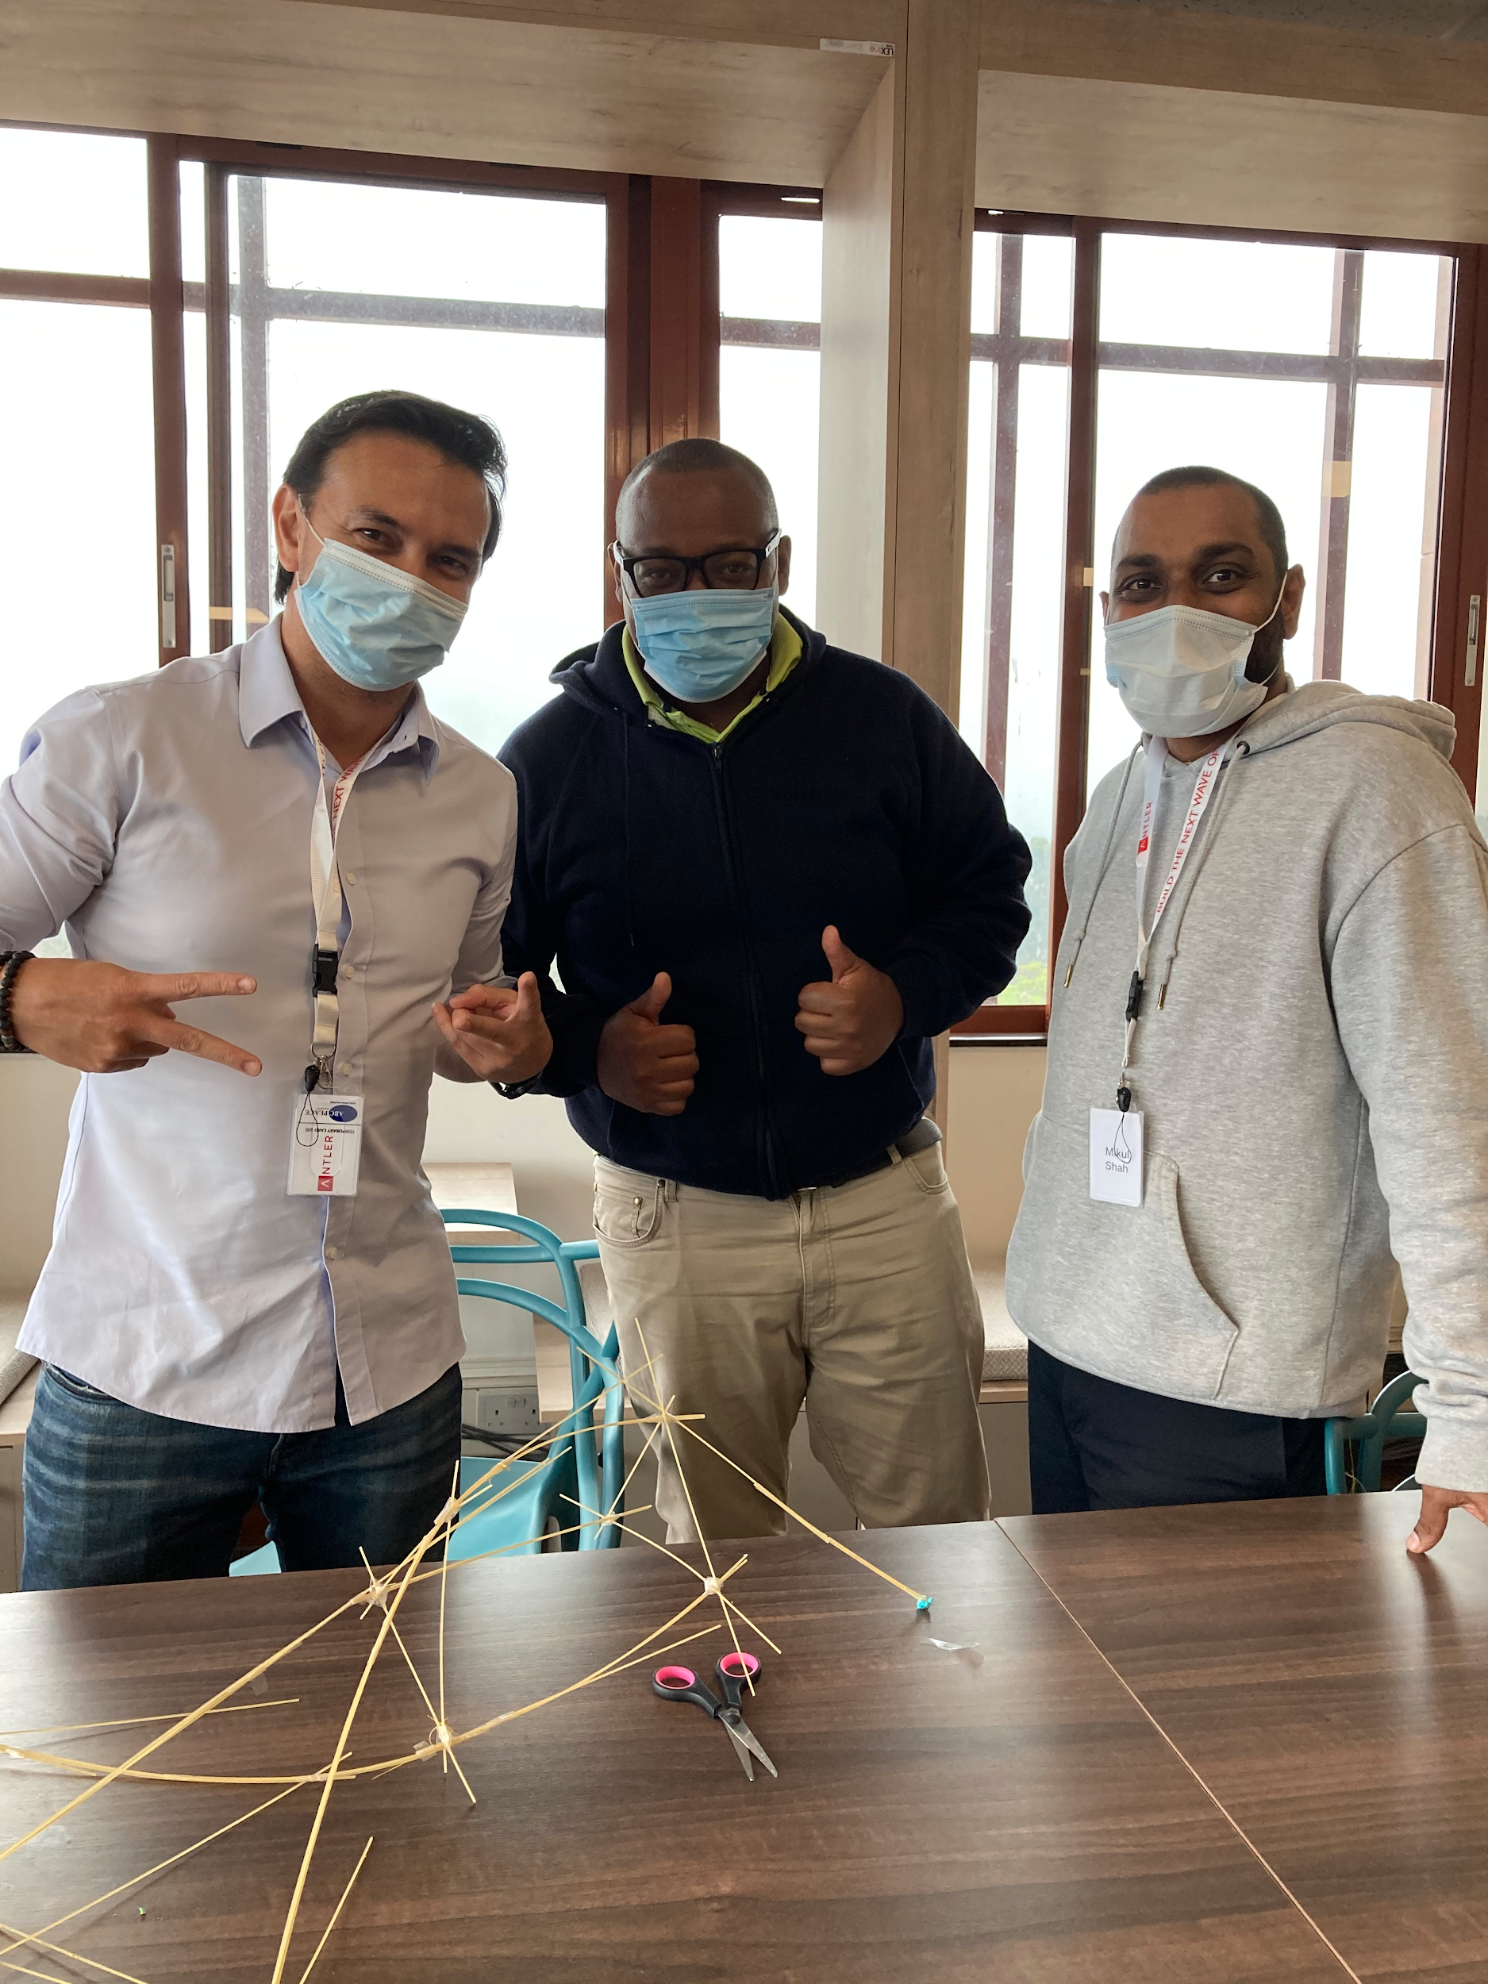
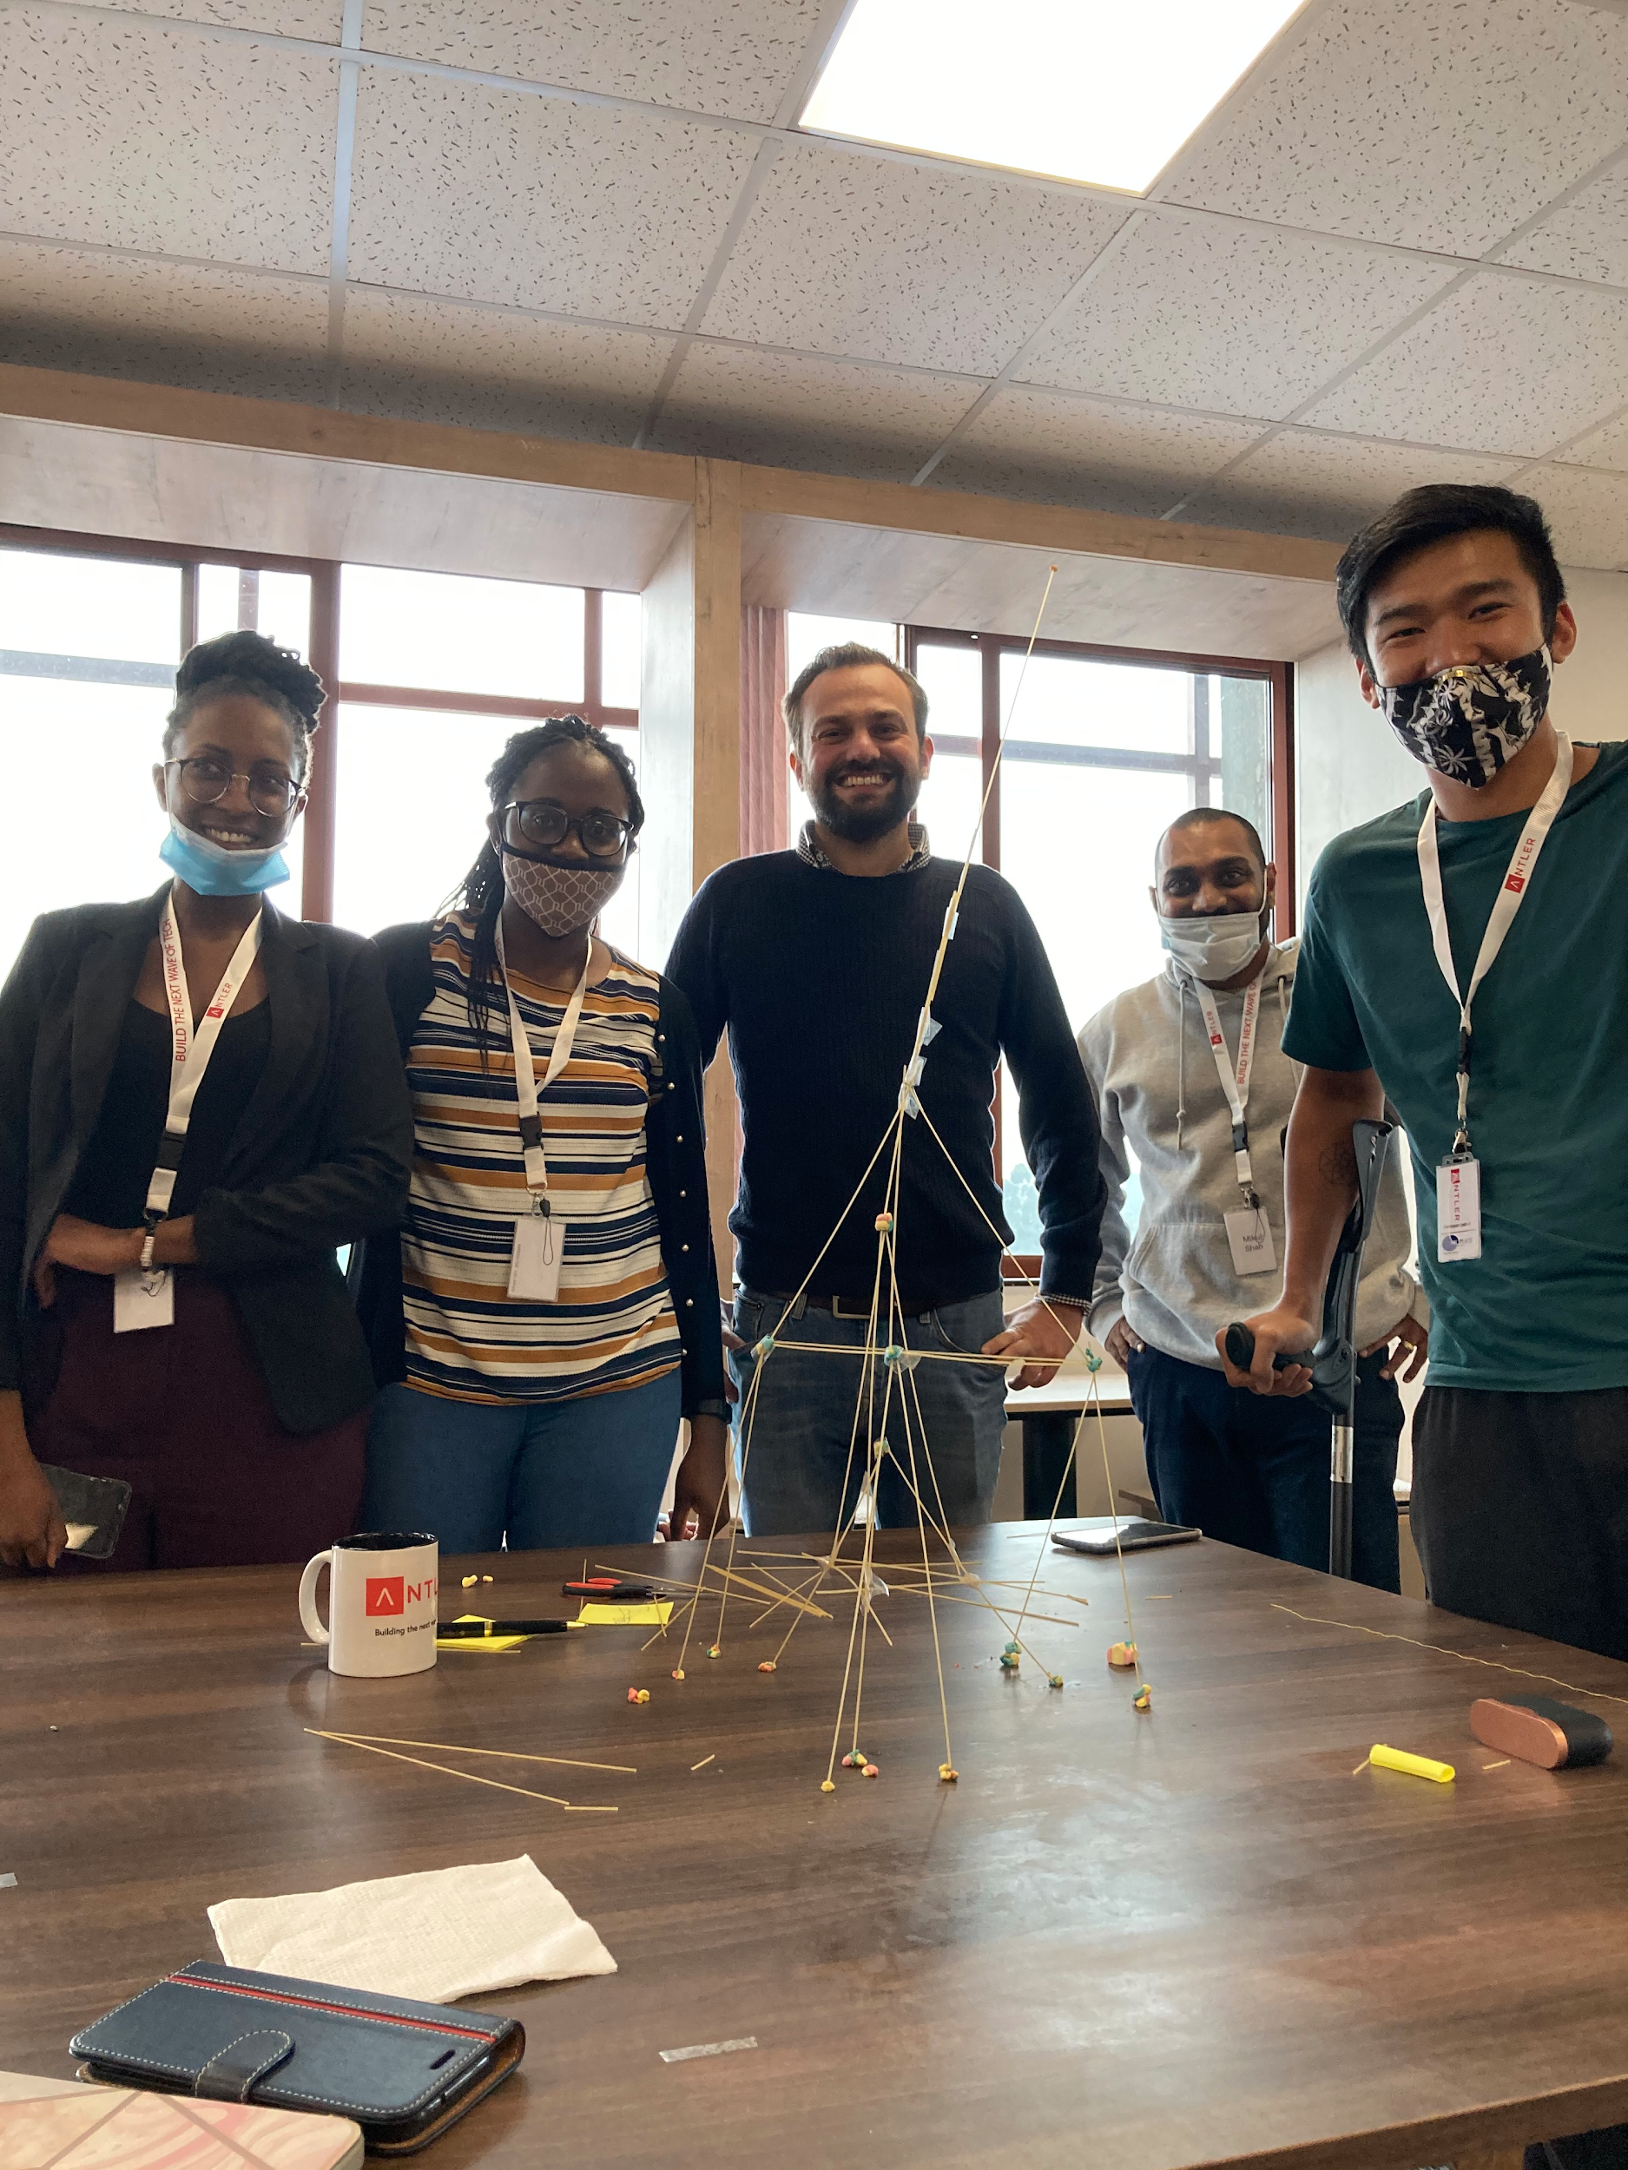
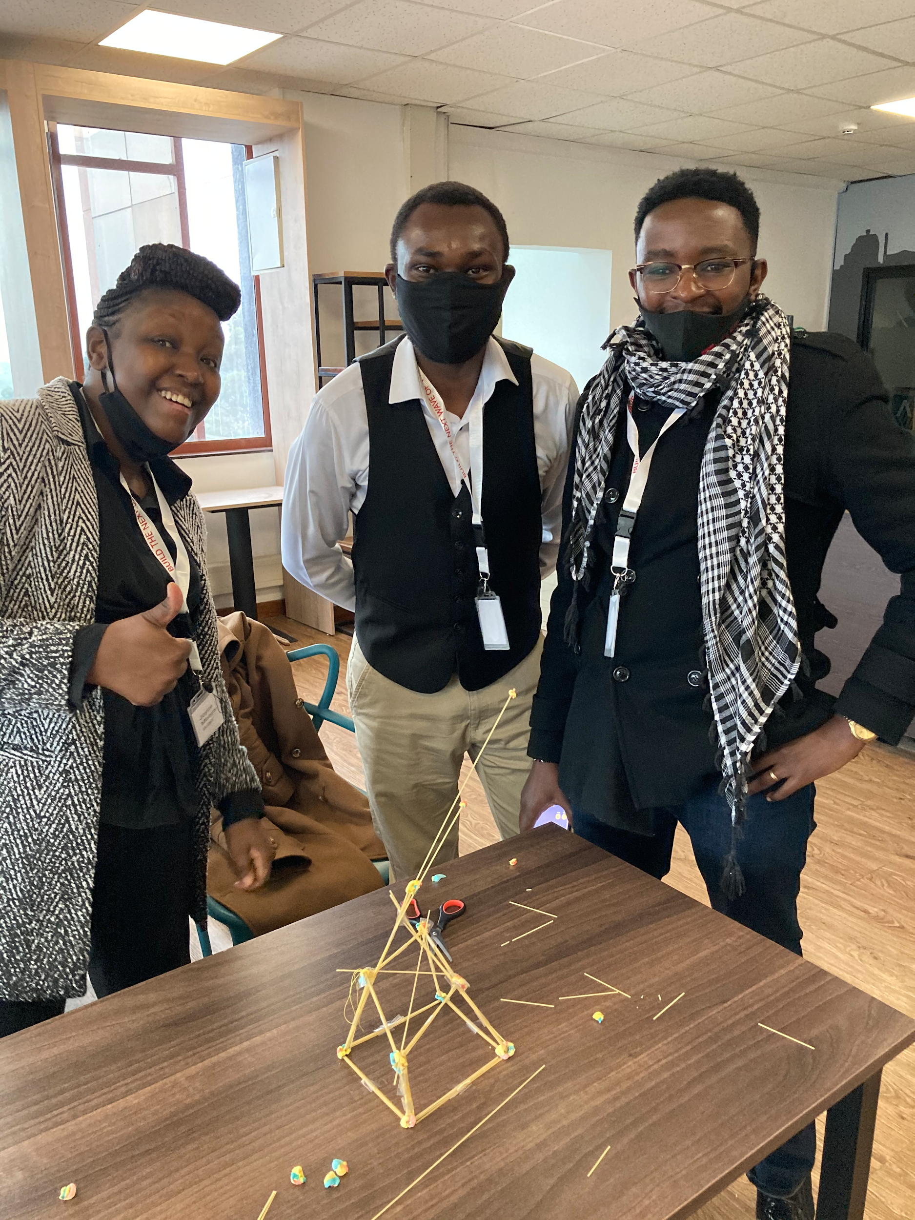
Team 3
Team 2
Team 6

Slide 20
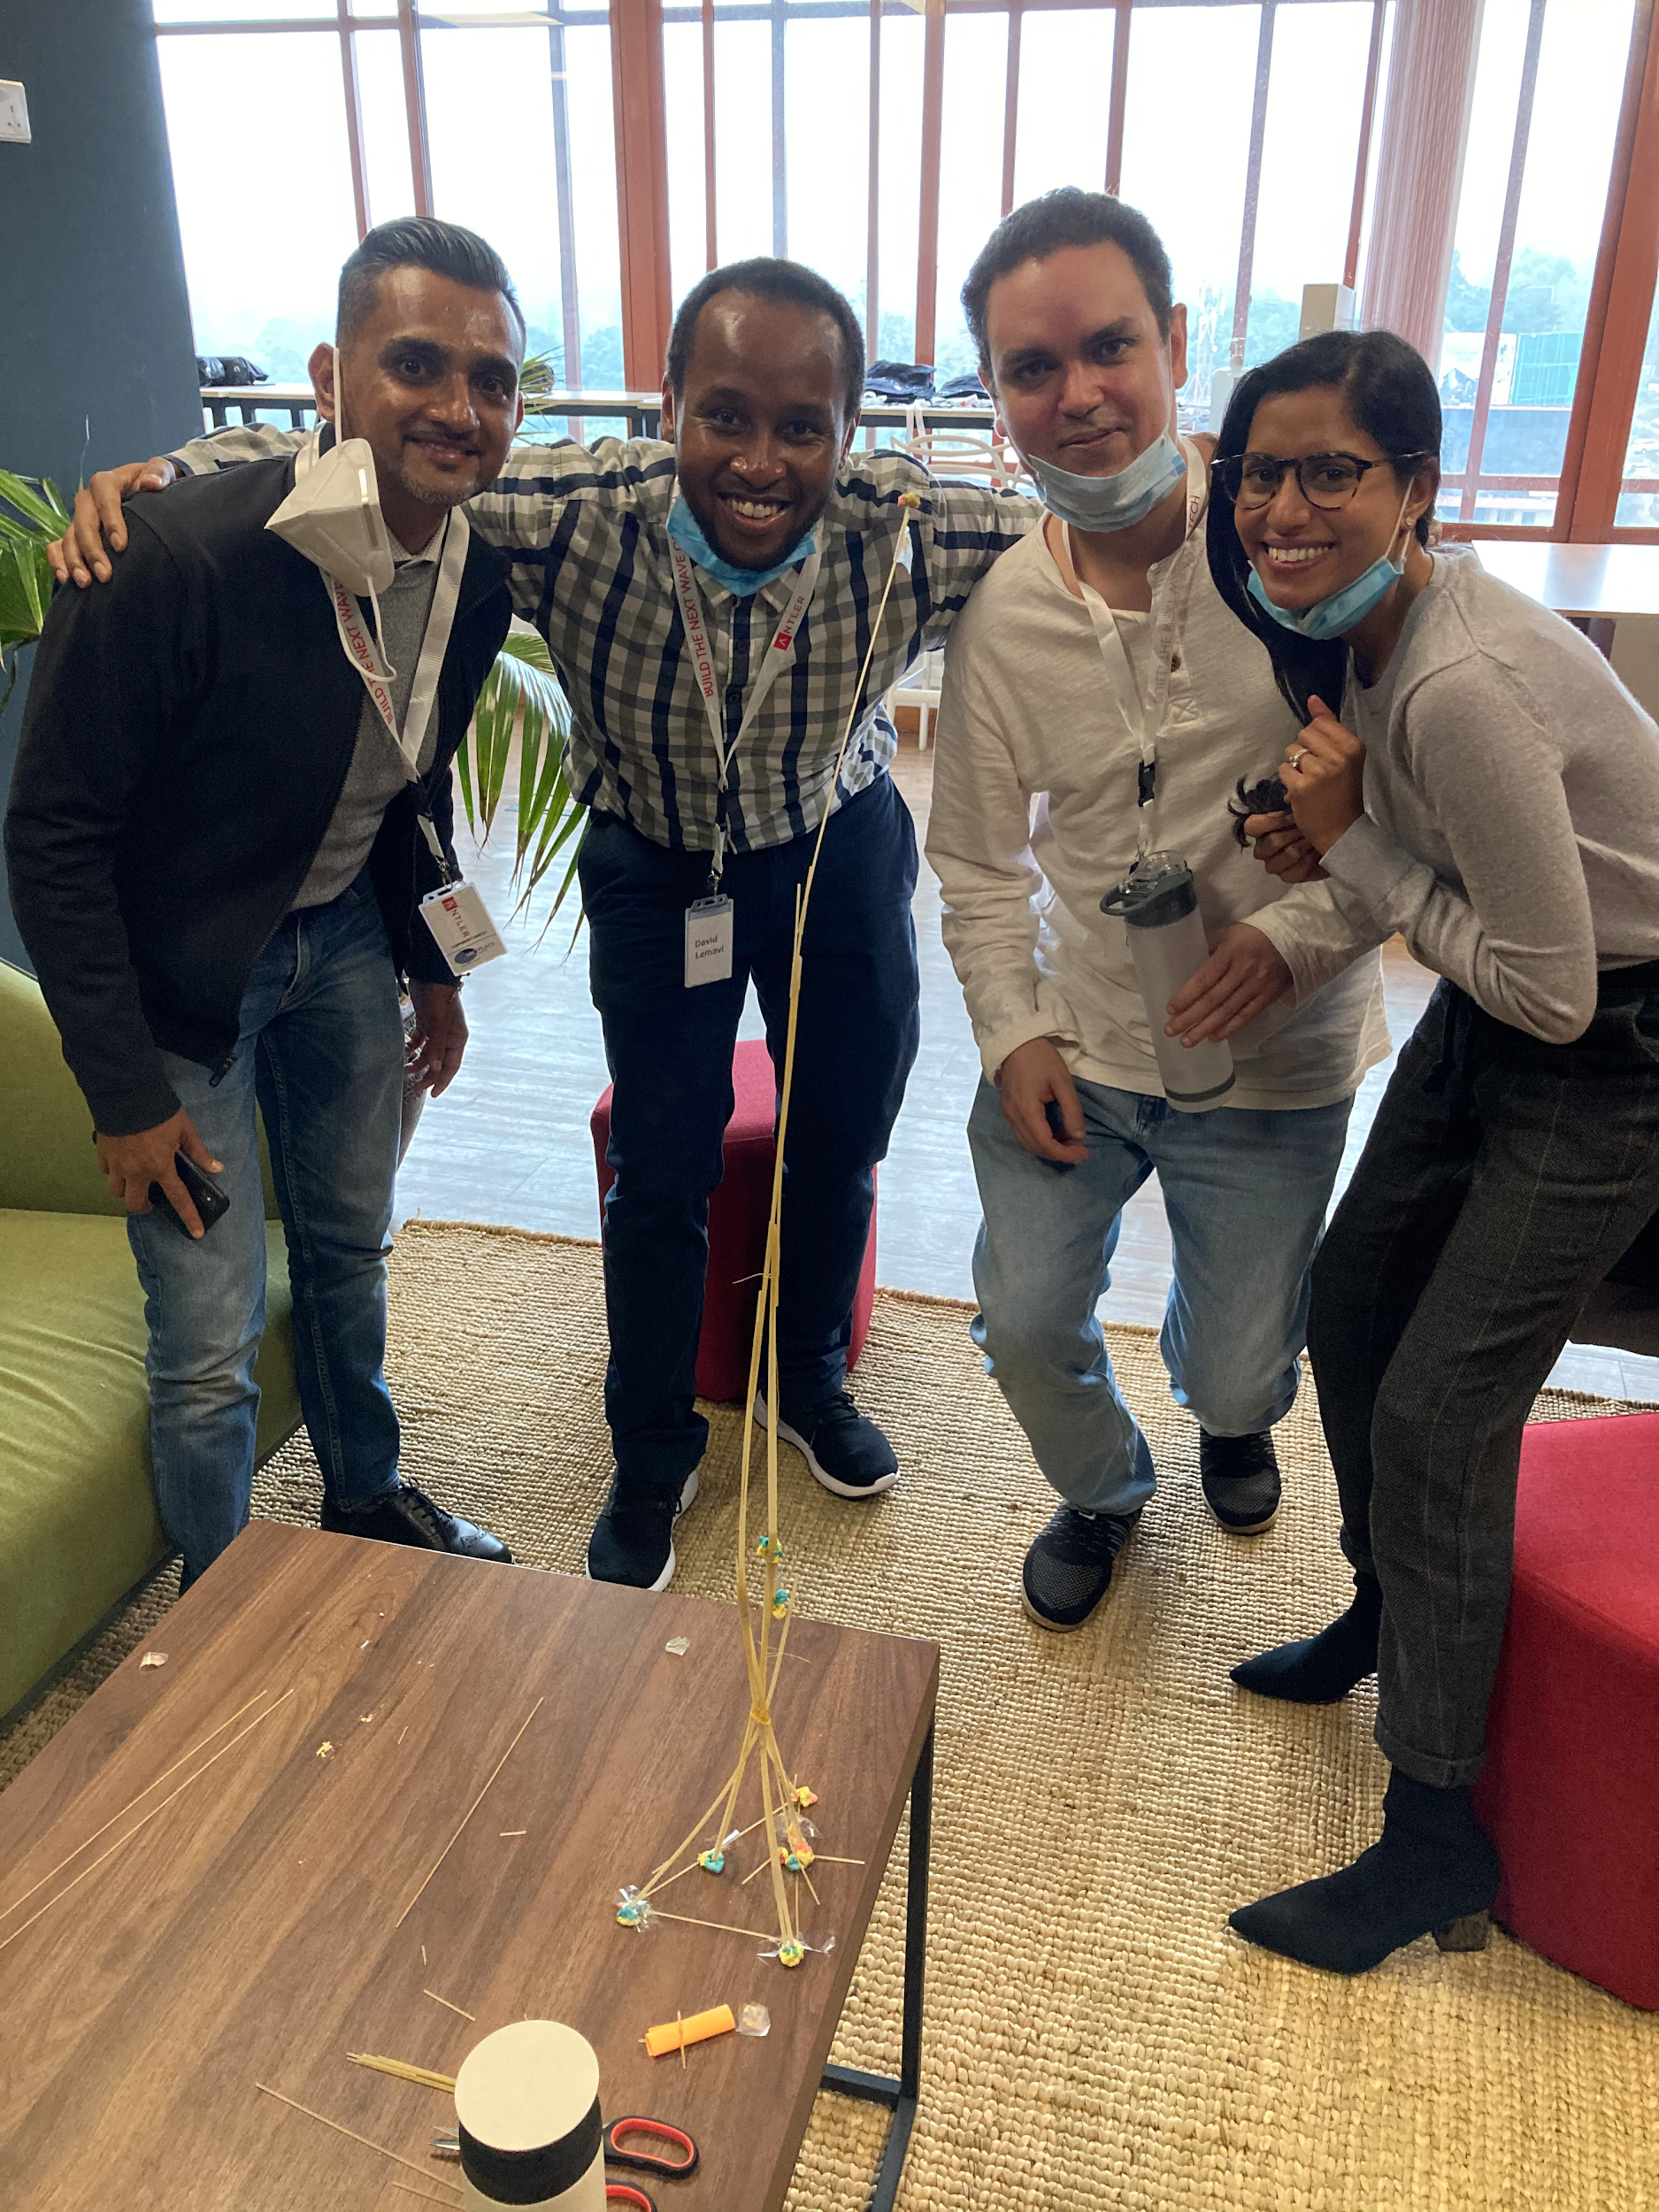
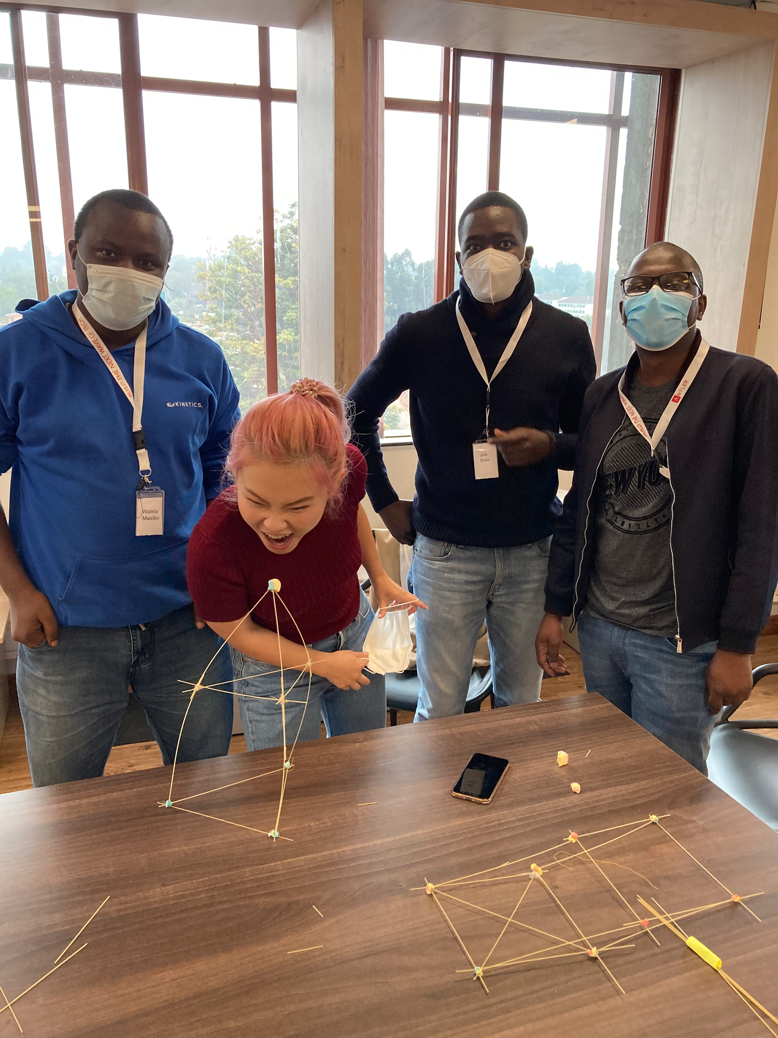
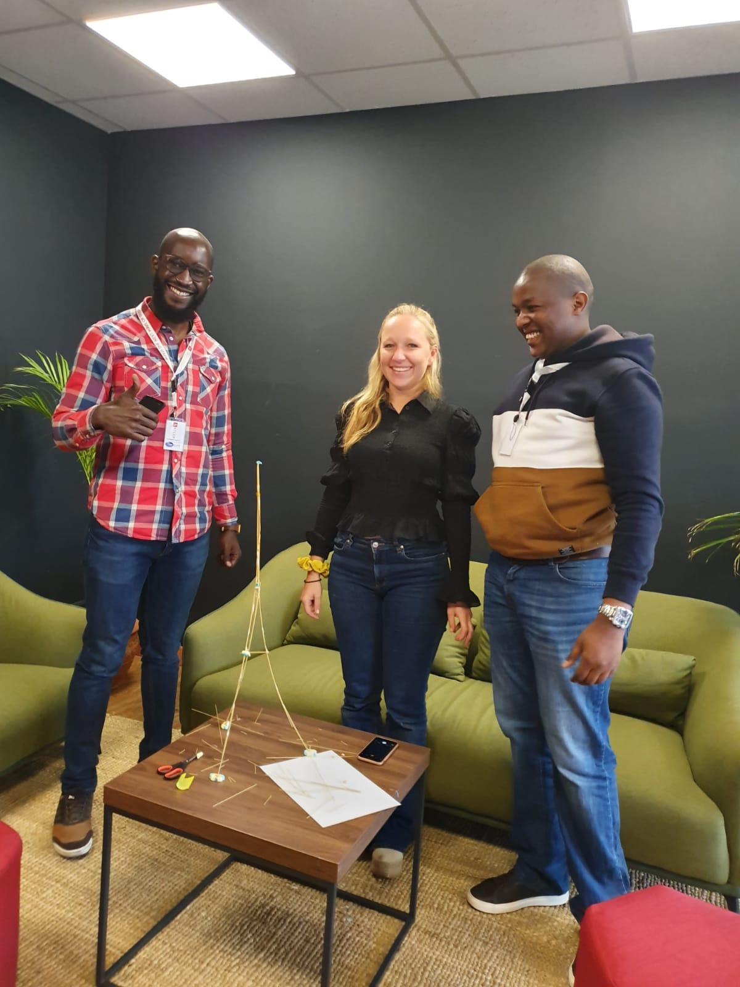
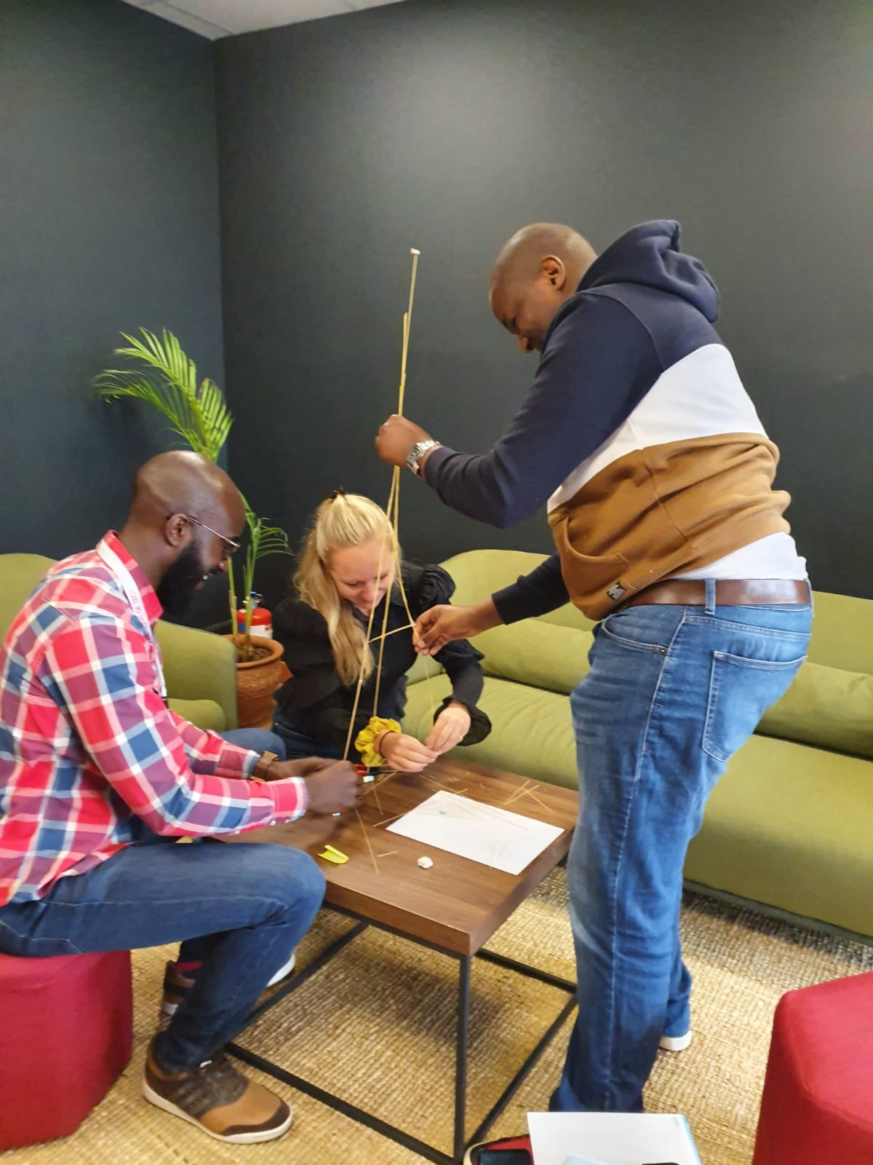
Team 1
Team 4
Team 5

Slide 21
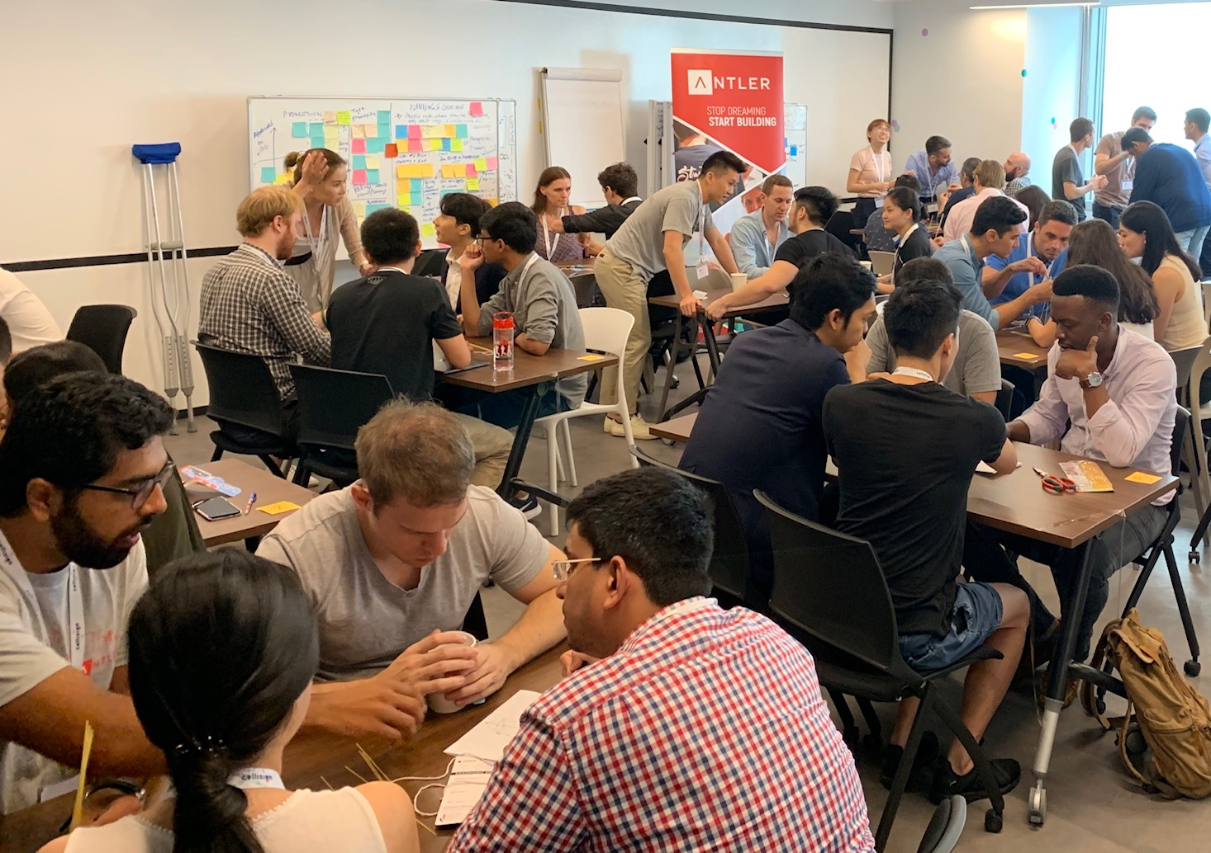
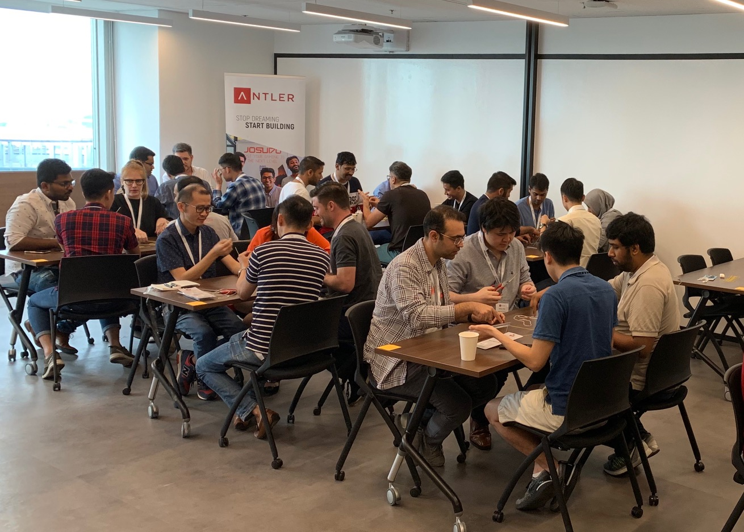
Team OCEAN Composition & Performance
Teams 1, 4, 5
Teams 2, 3, 6
Teams 1-9
Teams 10-23
Examples of “Unbalanced” OCEAN Teams:
Med Neuro, Med-High Extraversion
~Med Openness, High Extraversion
~Low-Med Extraversion, High Opennes
“Unbalanced” Teams
”Balanced” teams with complementary personalities
Who
Average of 42 cm
33 % of teams: Tower heights = 0
Average of 50 cm
0% of teams: Tower heights = 0
Performance

Slide 22
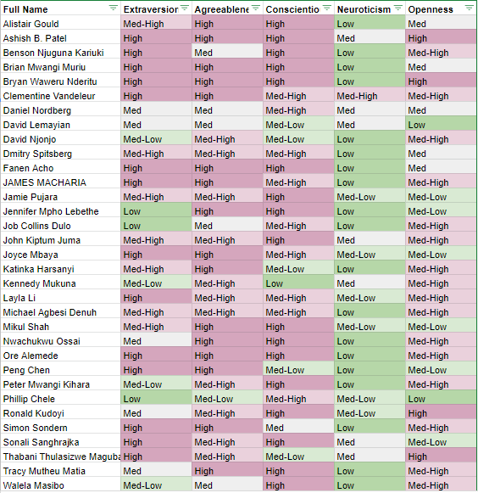

Slide 23
3 of 4
FINDING THE RIGHT CO-FOUNDER: THE 2P3 FRAMEWORK
1 – PROFESSIONAL
2 – PERSONAL
Skills
Company Vision
Commitment
(Culture)
Personal Affinity
1
2
3
3
Personality
Values
Personality
2
1
1
YOUR IDEAL CO-FOUNDER

Slide 24
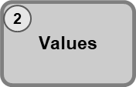
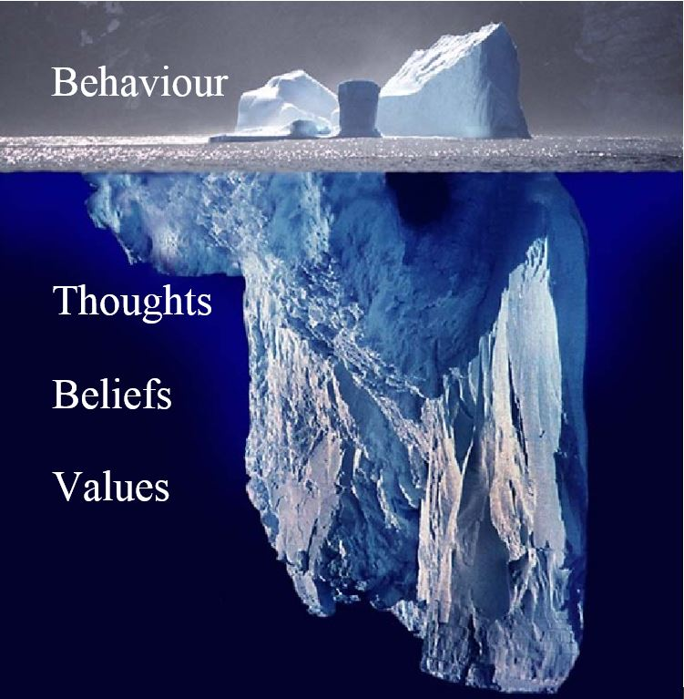
Core Values
Core values are the fundamental beliefs of a person or organization. These guiding principles dictate behaviour and can help people understand the difference between right and wrong.

Slide 25
Values and their Impact
Activity:
Pick your 5 most important values (3 min) and write them down.
Turn to the person next to you and discuss (5 min)
Why do you think you have these values?
How do they influence your behaviour?
Are any of them the driver behind your decision to become a founder?
Authenticity
Achievement
Adventure
Authority
Autonomy
Balance
Beauty
Boldness
Compassion
Challenge
Citizenship
Community
Competency
Contribution
Creativity
Curiosity
Determination
Fairness
Faith
Fame
Friendships
Fun
Growth
Happiness
Honesty
Humor
Influence
Inner Harmony
Justice
Kindness
Knowledge
Leadership
Learning
Love
Loyalty
Meaningful Work
Openness
Optimism
Peace
Pleasure
Poise
Popularity
Recognition
Religion
Reputation
Respect
Responsibility
Security
Self-Respect
Service
Spirituality
Stability
Success
Status
Trustworthiness
Wealth
Wisdom
*These are just examples, you are free to pick other values that come to your mind

Slide 26
4 of 4
FINDING THE RIGHT CO-FOUNDER: THE 2P3 FRAMEWORK
1 – PROFESSIONAL
2 – PERSONAL
Skills
Vision
Commitment
(Culture)
Personal Affinity
1
2
3
3
Personality
Values
Personality
2
1
1
YOUR IDEAL CO-FOUNDER

Slide 27

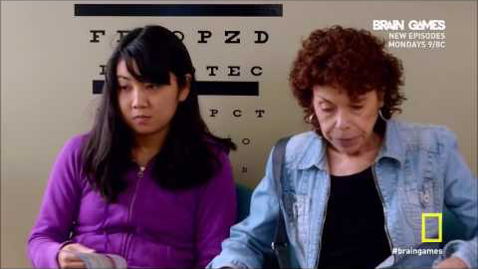

Slide 28
Definition of culture and the GlobeSmart cultural assessment
“Culture is the collective programming of the mind which distinguishes the members of one human group from another” (G. Hofstede, 1980)
The Five Dimensions of the GlobeSmart (GS) Profile
Exists as a cultural awareness tool
Helps individuals understand their own preferences and tendencies for interacting with others
Allows for comparisons with other individuals as well as with other cultures
Independent / Interdependent
Egalitarism / Status
Risk /
Certainty
Direct /
Indirect
Task /
Relationship
Notes:
Ask Group: what does culture mean to them? Discuss national and corporate
Simply put, culture is “How we do things here”

Slide 29


Independent / Interdependent – How do I derive my identity?
Independent
Interdependent
Place great importance on individual identity
Derive identity from personal choices and achievements
Prefer taking action on one's own
Place great importance on group harmony and cooperation
Derive identity from group affiliation
Feel a sense of duty, obligation, and loyalty to ascribed groups
Notes:
Can you think of a culture that is characteristic independent? What about interdependent?

Slide 30


Egalitarianism/Status – What is my preference for how my group should be structured and how power should be distributed?
Egalitarianism
Status
Be comfortable challenging the views of superiors
Treat everyone much the same
Assume power and authority should be shared broadly among a group
Prefer not to challenge those above
Adapt their behavior depending on relative status
Assume power & authority should be reserved for a few members of group
Notes:
Representative cultures?

Slide 31

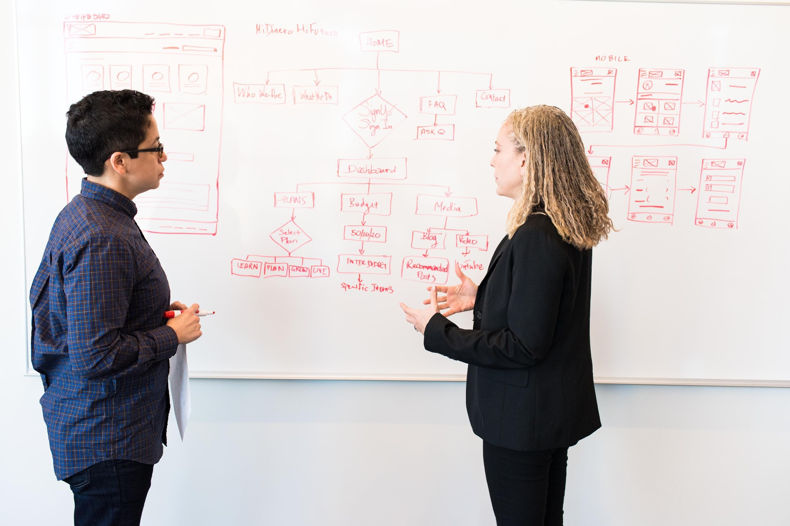
Risk / Certainty – How do I make decisions in uncertain situations?
Risk
Certainty
Prefer rapid decision-making and quick results
Place great importance on flexibility and initiative
Value speed over thoroughness
Spend significant time on background research
Establish proper procedures before starting a project
Value thoroughness over speed
Notes:
What culture is a startup culture better off with?

Slide 32


Direct / Indirect – When working on new projects, do I prefer to address tasks or relationships first?
Direct
Indirect
Come to the point quickly
Comfortable making requests, giving direction, or disagreeing with others
Give negative feedback directly
Spend time explaining the context before coming to the point
Express disagreement in subtle ways
Give negative feedback indirectly
Notes:
We are very direct here at Antler… so please do not take offense at our feedback

Slide 33

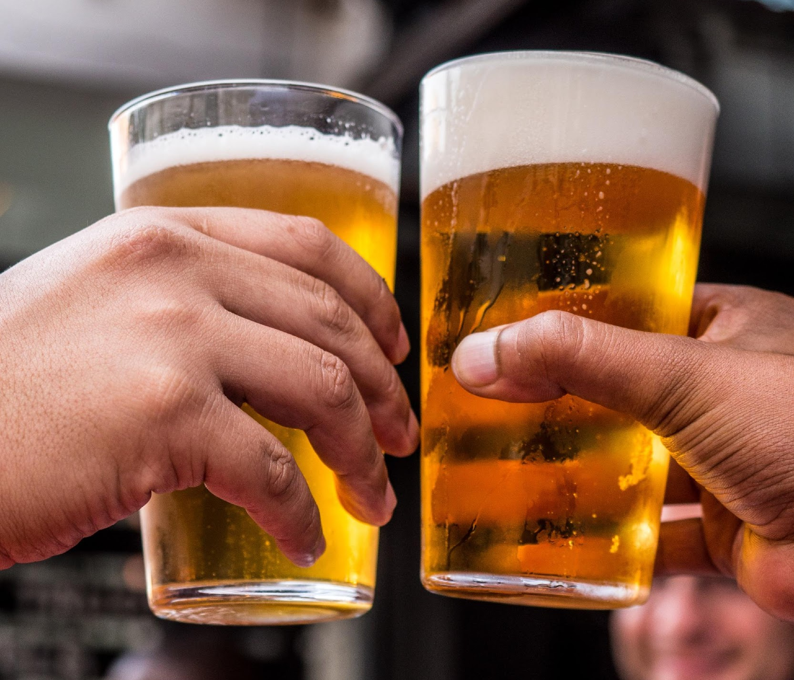
Task / Relationship – Which do I subconsciously and consciously prioritize?
Task
Relationship
Place high value on reaching goals and objectives on schedule
Prioritize accomplishing tasks over maintaining relationships
Focus on what people achieve more than who they know
View time building relationships as key to achieving good results
Prioritize maintaining relationships over accomplishing tasks on time
Focus on who people know as much as what they themselves can achieve
Notes:
Cultures? People may change depending on their environment

Slide 34
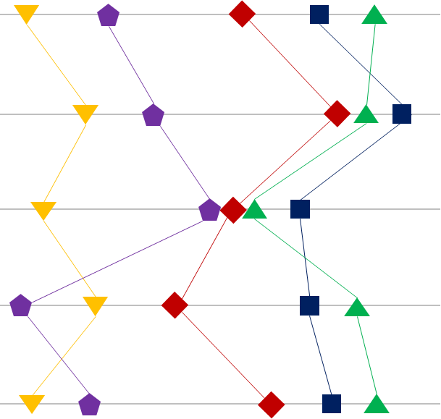
GlobeSmart Country Profiles
Independent
Interdependent
Singapore
Egalitarianism
Status
India
Risk
Certainty
China
Direct
Indirect
USA
Germany
Task
Relationship

Slide 35

Diversity of culture and personality is essential to founding teams
Better customer understanding
LinkedIn 2018: Nearly half (49%) of employers say they focus on diversity to better represent their customers
Greater innovation & creativity
HBR 2018: Cognitively diverse teams solve problems much faster (HBR, 2017)
Easier to hire and retain talent
Women Ahead 2017: Supporting employee networks for specific demographic groups has a direct link to employee retention and engagement
Better business results
HBR 2018: The more similar the investment partners were to the founders, the lower their investments’ performance
Notes:
Greater innovation / creativity:
Cognitively diverse teams solve problems much faster (HBR, 2017)
When employees think their organisation is committed to diversity, and they feel included, their ability to innovate increases by 83% (Deloitte, 2013)

Slide 36
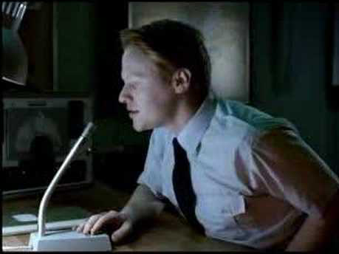
The dangers of diversity when no frame is set in place
Notes:
….so then this slide says, in a humoristic manner, that diversity is good only when managed well

Slide 37

Antler Program: Finding a Co-Founder
A founding relationship is like being in a marriage, but many founders’ relationships come together much more quickly than a marriage, with much less dating time involved…
… hence Antler’s Program is designed to optimize and expedite co-founding
Notes:
Ask Team A (complementary): How was it? What went well, what did not go so well? How did the personalities match? -> show them dashboard
Ask Team Z (disfunctional) same questions
Show them slide with results: height of tower (hopefully disfunctional team got a lot lower tower)
Give them averages of the two types of teams (on 2 slides) - without revealing what the difference was
Reveal in dashboard what we did with teams

Slide 38
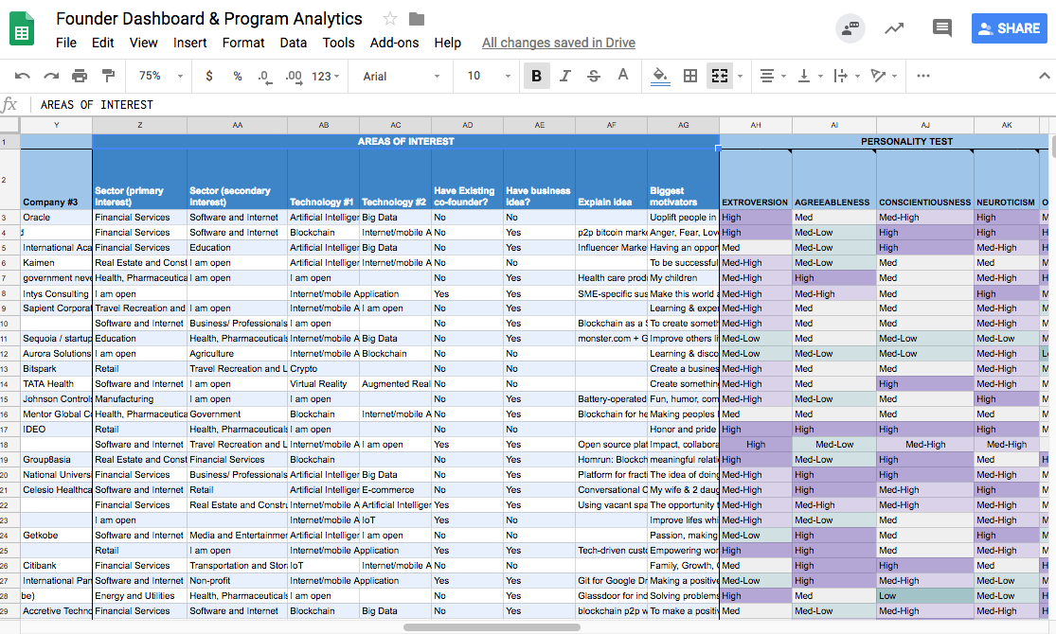
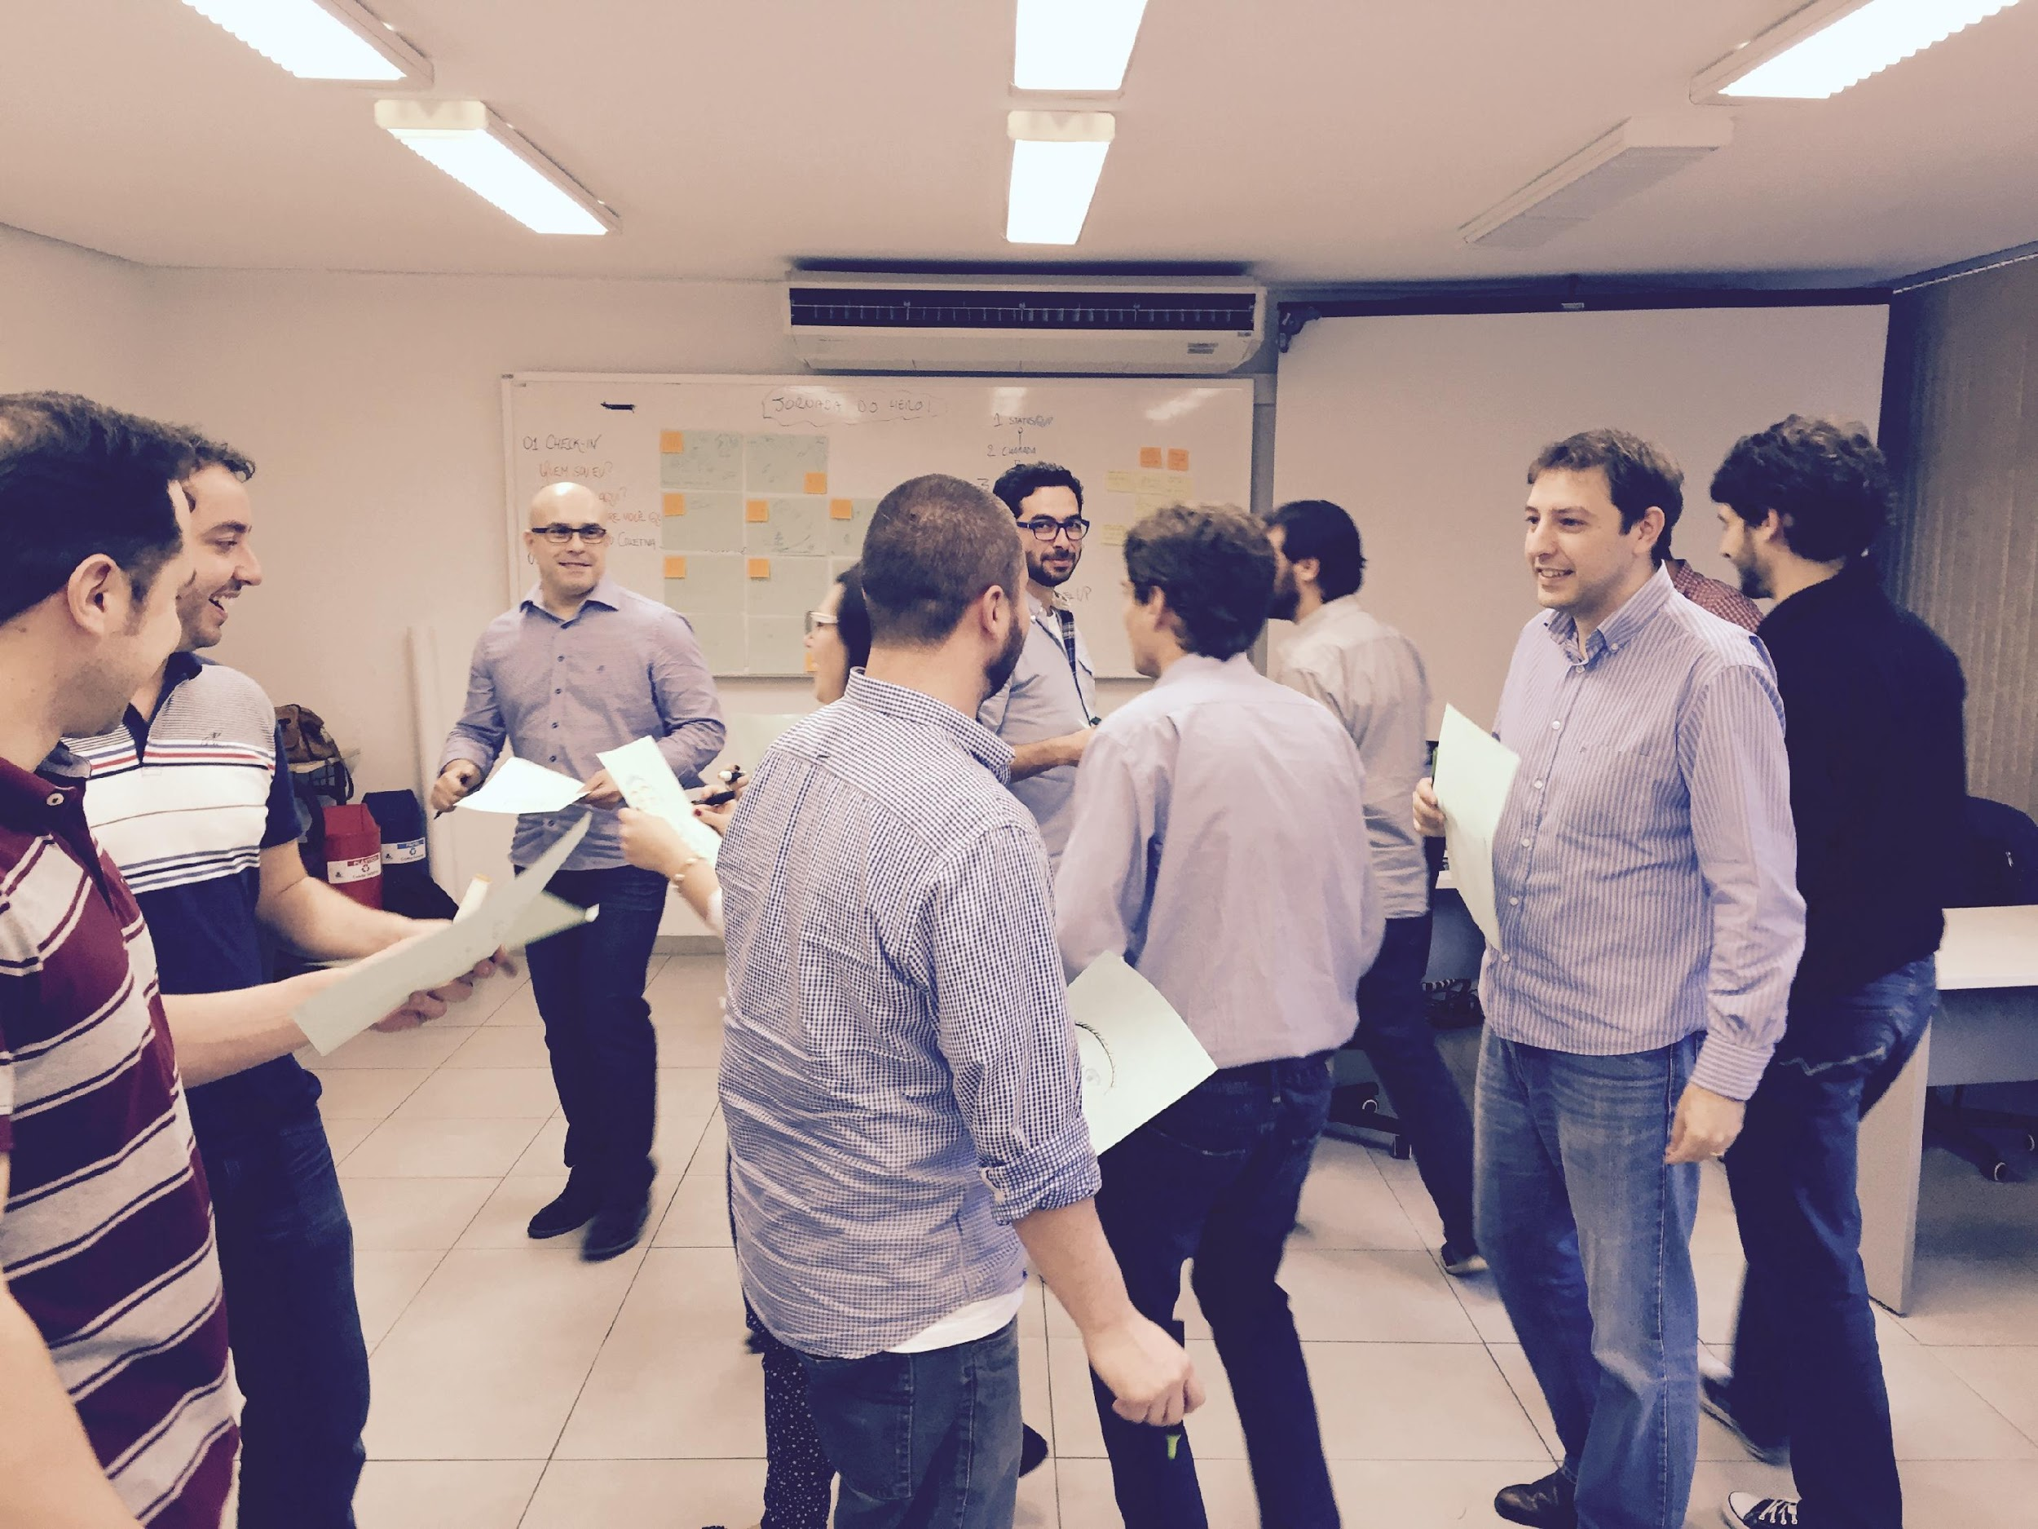
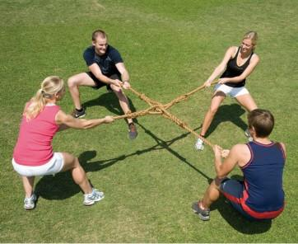
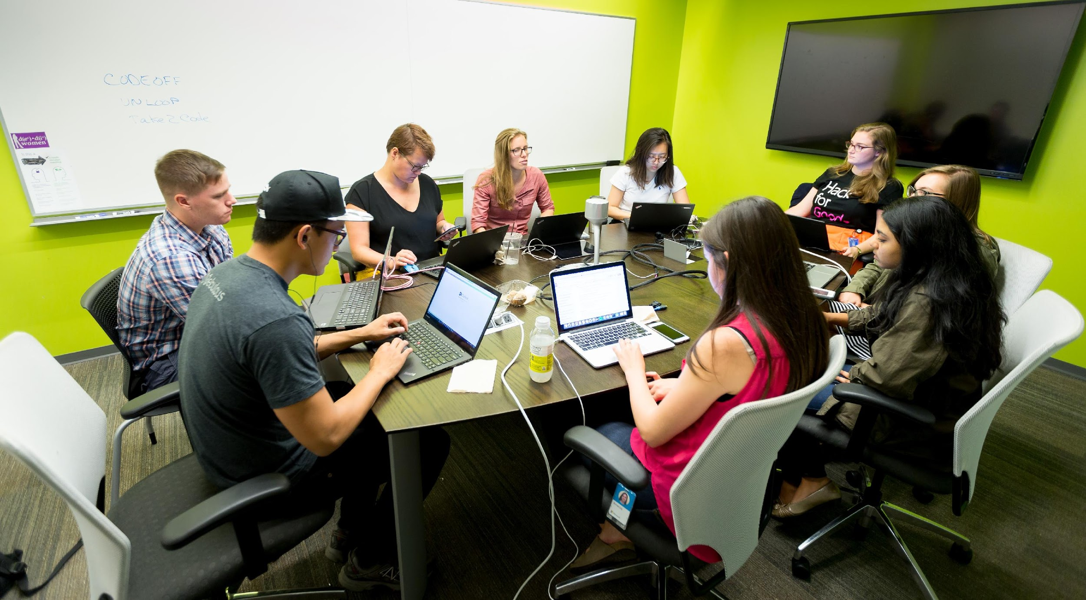
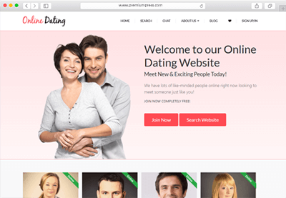

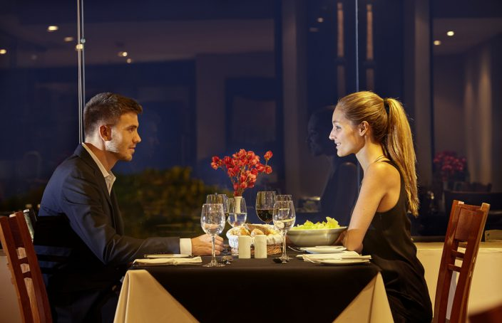

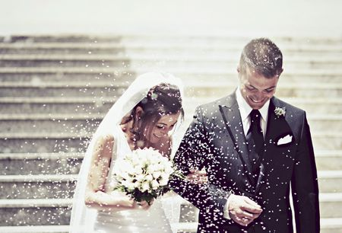
Antler Program: Finding a Co-Founder
Founder Dashboard
Mixers / Drinks
Bootcamps
Tracking out
Co-founding
Antler helps you identify a co-founder…
…in the same way dating and marriages work
Matching
Algorithms
Socials
Dating
Moving in Together
Marriage

Slide 39

DON’T BE AFRAID TO EXPERIMENT EARLY
Week 1
Week 2
Week 3
Week 4
Week 5
Week 6
Week 7
Week 8
Bootcamp Track
Bootcamps
Track-Out Session
We want to
build a team!
This doesn’t work; let’s break up!
Company Building Track
Coaching Sessions & Countdown to IC

Slide 40
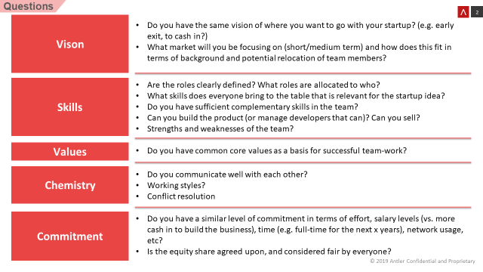
TRACK-OUT SESSION CHECKLIST

Slide 41
Challenge yourselves before forming a team (else potential investors & competitors will do it for you)
. . .
But do not overthink about it – experiment more and overanalyze less

